Slide 1

AI - POWERED ACCESSIBILITY FOR EFFECTIVE COMMUNICATION IN VIRTUAL PLATFORMS

Slide 2

Team Guide Name
-
Dr. J. DAPHNEY JOANN
Team Members
  Dinesh Kumar. G - 510921104009
  Mohammed Shamil - 510921104028
  Raashid. A - 510921104040
  Santhosh. V - 510921104047

Slide 3
CONTENTS
  Abstract
  Introduction
  Objectives
  Literature Survey
  Existing System
  Existing Algorithm
  Disadvantages
  Proposed System
  Advantages
  Software Requirement
  System Architecture
  Modules
  C:onclusion
  Future Scope
  References

Slide 4
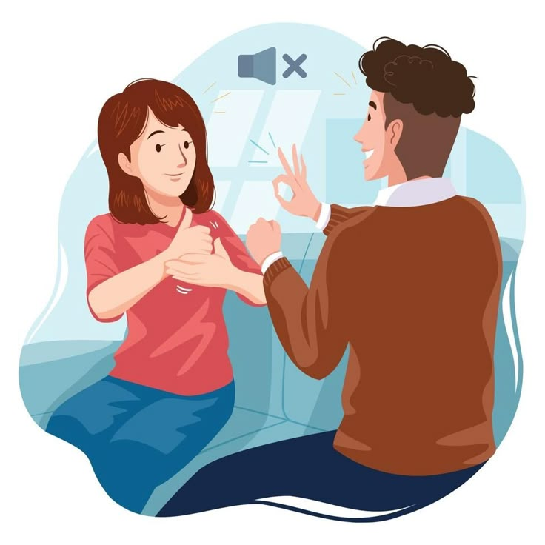

ABSTRACT
This project aims to create an AI-powered system to bridge the communication gap between hearing and speech-impaired individuals and hearing individuals in virtual meetings. The system features a Sign Recognition Module (SRM) for sign language interpretation, a Speech Recognition and Synthesis Module (SRSM) for text conversion, and an Avatar Module (AM) for visually translating speech into sign language. This system enhances inclusivity and enables seamless, real-time communication for diverse users.

Slide 5
INTRODUCTION
  Effective communication is essential for sharing information, ideas, and emotions, especially in diverse social settings.
  Individuals with hearing and speech impairments face significant challenges in virtual and physical communication.
  Existing sign language recognition technologies and virtual platforms often lack inclusivity and real-time functionality.
  There is a growing need for advanced AI-driven solutions to bridge communication gaps in virtual environments.
  This project aims to develop an inclusive system that integrates sign language recognition and avatar-based translation for seamless communication.

Slide 6
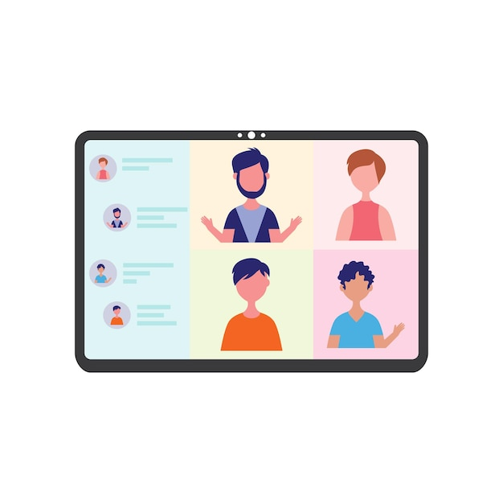
OBJECTIVES
  To develop and build the deaf companion System.
  To enable two-way communication between deaf and normal people.
  To design and develop a high-performance sign recognition module.
  To generate high-quality speech from the text.
  To transform the text from a normal individual into SL through an Avatar.
  To integrate the system into virtual platforms for seamless communication.

Slide 7
LITERATURE SURVEY
No | Paper Info | Objective | Author | Year
1 | Title: Continuous Sign Language Recognition With Multi-Scale Spatial-Temporal Feature Enhancement | To improve real-time sign language recognition accuracy by using spatial temporal feature extraction techniques. | Zhen Wang; Dongyuan Li; Manabu Okumura | 2025
2 | Title: A Holistic Approach to Enhance Learning Experiences for People With Hearing Disabilities in Online and Traditional Classroom Settings | To enhance learning accessibility for people with hearing disabilities in hybrid and online education | Mario Perez-Enriquez; Jose Luis Lopez-Cuadrado; Israel Gonzalez-Carrasco | 2024
3 | Title: Hand and Pose-Based Feature Selection for Zero-Shot Sign Language Recognition. | To perform Zero-Shot Sign Language Recognition (ZSSLR) using hand, pose, and body data. | Giray Sercan Özcan; Yunus Can Bilge | 2024

Slide 8
No | Paper Info | Objective | Author | Year
4 | Title: Hybrid InceptionNet Based Enhanced Architecture for Isolated Sign Language Recognition. | To improve recognition accuracy of isolated sign language gestures. | Deep R. Kothadiya; Chintan M. Bhatt | 2024
5 | Title: Deep Learning-Based Standard Sign Language Discrimination. | Discriminate standard vs non-standard SL actions in education software. | Menglin Zhang, Shuying Yang | 2023
6 | Title: Sign4all: A Low-Cost Application for Deaf People Communication. | Facilitate communication between deaf and hearing individuals using SL alphabet. | Francisco Morillas-espejo | 2023

Slide 9

EXISTING SYSTEM
Assistive Devices
Hearing Aids and Cochlear Implants: Traditional assistive devices include hearing aids and cochlear implants, which aim to improve auditory perception.
Manual Communication Tools
Pen and Paper: Traditional tools such as writing or using pen and paper are often employed for basic communication.
Interpreters
Sign Language Interpreters: In various situations, sign language interpreters are employed to bridge communication gaps between deaf and hearing individuals.

Slide 10

EXISTING ALGORITHMS
Support Vector Machines (SVMs)
SVMs have been employed for classification tasks in SLR. They work well with high-dimensional feature vectors extracted from sign language images.
Ensemble Learning
Ensemble methods, such as Random Forests and Gradient Boosting, can be applied to combine multiple SLR models to improve overall accuracy and robustness.
Gesture Recognition by Learning from Poses (GRBP)
GRBP is a method that focuses on learning spatial relations between body joint poses for sign language recognition. It utilizes pose features extracted from skeletal data.

Slide 11
DISADVANTAGE
  Traditional systems lead to limited accessibility, hindering communication with non-signers.
  Real-time processing challenges persist, especially for resource-constrained devices.
  Existing algorithms lack adaptability to diverse sign language variations.
  Difficult to interpret the decision-making process.
  Face challenges in adapting to unseen variations or emerging sign language expressions.
  Many systems fail to provide real-time translation, causing delays in communication.
  Virtual platforms often lack robust support for inclusive communication, making it difficult for hearing-impaired users to engage fully.

Slide 12
PROPOSED SYSTEM
The proposed system integrates advanced AI technologies, to create a seamless, real-time communication experience for hearing and speech-impaired individuals in virtual meetings.
Deaf Companion System
The proposed system aims to enhance communication for individuals with hearing and mute disabilities through innovative technologies.
Two-Way Communication
Implementation of a comprehensive two-way communication system, fostering seamless interaction between deaf individuals and the broader community in virtual meeting platforms.
SignNet Model Architecture
Development of the SignNet Model, combining Convolutional Neural Networks (CNN) and Temporal Convolutional Networks (TCN) for robust sign language recognition.

Slide 13
Sign Language Recognition Module (SRM)
The Sign Recognition Module (SRM) utilizes Temporal Convolutional Networks (TCNs) to accurately interpret sign language in real-time. This allows for seamless communication between hearing and speech-impaired individuals by converting gestures into understandable text or speech.
Speech Recognition and Synthesis Module (SRSM)
The Speech Recognition and Synthesis Module (SRSM) employs Hidden Markov Models (HMMs) to transform spoken language into text, enabling easy comprehension for both deaf and hearing users. It ensures that spoken words are effectively converted into accessible formats.
Avatar Module (AM)
The Avatar Module (AM) visually translates spoken language into corresponding sign language using 3D animation.
Integration with Virtual Platforms
The system is designed to be integrated with popular virtual platforms. This ensures that inclusivity is maintained, and all users, regardless of their communication abilities, can participate effectively in virtual meetings.

Slide 14
ADVANTAGE
  Bridges communication gaps for hearing and speech-impaired individuals.
  Provides accurate, real-time sign language and speech-to-text conversion.
  Utilizes TCNs and HMMs for high accuracy.
  Easily integrates with Virtual platforms.
  Includes Avatar Module for visual sign language representation.
  Reduces need for physical interpreters.
  Enhances user participation with a more intuitive experience

Slide 15
SOFTWARE REQUIREMENT
  Programming Languages: Python 3.
  Web Development Tools
Flask: Web framework for handling requests and serving the application.
WampServer: Local server environment for running the Flask application
  AI & Machine Learning Tools
Tensor Flow: For hand gesture recognition in video streams.
OpenCV: For video capture and processing.
  Video Calling Tools: jitsi-For enabling real-time video calls.
  Database: MySQL-For storing user and meeting data (managed via WampServer).

Slide 16
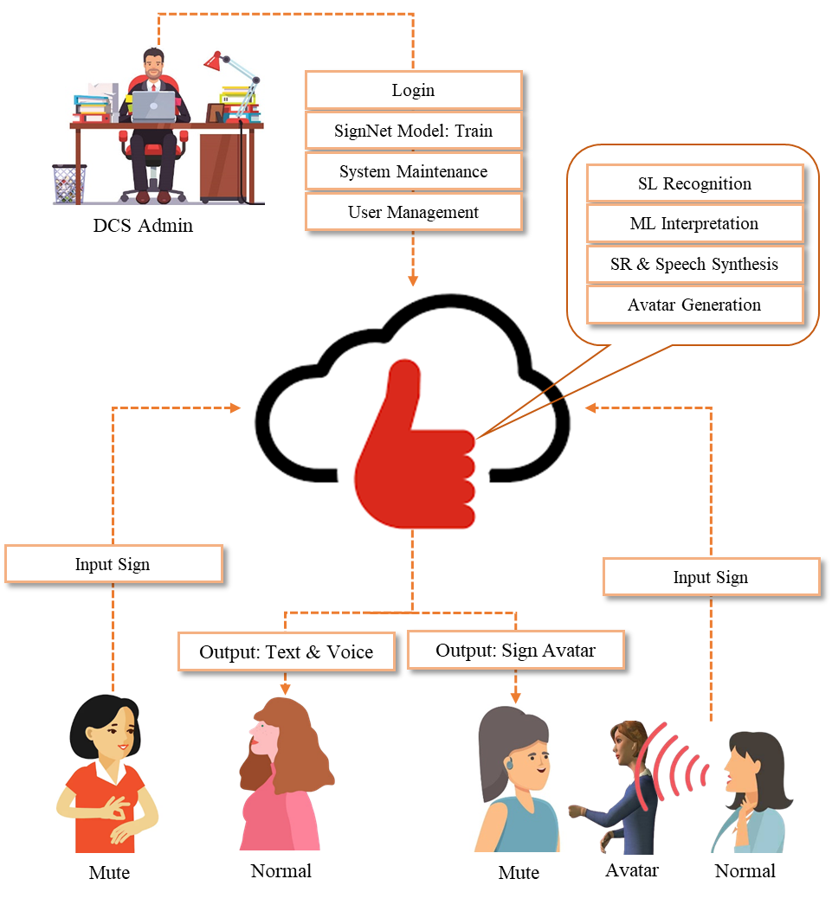
SYSTEM ARCHITECTURE

Slide 17
MODULES
1. Deaf Companion System
2. System User Dashboard
2.1. Admin
2.2. Deaf
2.2. Non-Deaf
3. SignNet Model: Build and Train
3.1. Import Dataset
3.2. Preprocessing
3.3. Segmentation
3.4. Feature Extraction
3.4. Classification
3.5. Build and Train
3.6. Deploy Model
4. Sign Language Recognition
4.1. Live Video with Sign
4.2. Recognize Sign
4.3. Multilanguage Interpretation
5. Speech Recognition and Synthesis
6. Avatar Generation

Slide 18
  SignMeet Web App
  The SignMeet Web App is designed to provide a groundbreaking solution for individuals with hearing and mute disabilities in virtual meeting platforms.
  he User Authentication module establishes secure access, while the Dashboard serves as a central hub for seamless navigation.
  The Sign Language Recognition interface allows users to input gestures for real-time interpretation, complemented by the Speech-to-Text interface for comprehensive communication.
  The Avatar Customization module enables personalization, and language, cultural, and accessibility settings enhance adaptability.
  The Admin Dashboard provides tools for training model, monitoring and system management. This design ensures a holistic and accessible platform for individuals with hearing and mute disabilities.

Slide 19
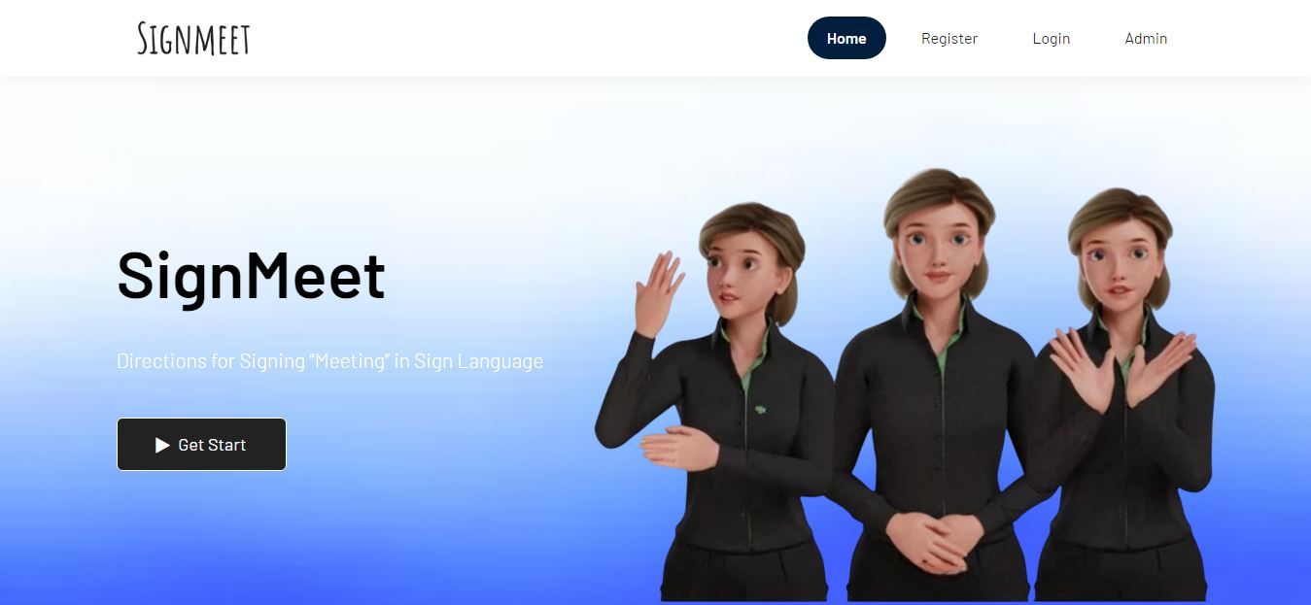
Sample Screenshot

Slide 20
2. System User Dashboard
2.1. Admin
Login
  Admin authentication for secure access to the system's administrative functions.
Build and Train SignNet Model
  Dedicated functionality for the admin to initiate the building and training process of the SignNet Model.
User Management
  Admin-exclusive capabilities to manage user profiles, permissions, and system maintenance tasks.

Slide 21
2.2. Deaf User
Show Sign into the Webcam
User interface allowing deaf individuals to display sign language gestures through their webcam for real-time interpretation.
Deaf View Avatar with Predicted Sign
Deaf users receive visual representation through avatars synchronized with the predicted sign language gestures based on the spoken words.
2.3. Non-Deaf User
Speak Using Mic
User interface enabling non-deaf individuals to communicate verbally using a microphone.
Non-Deaf Receive
View text representations and hear voice outputs corresponding to the predicted sign language gesture.

Slide 22
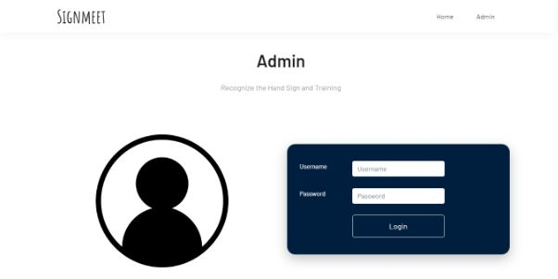

Slide 23
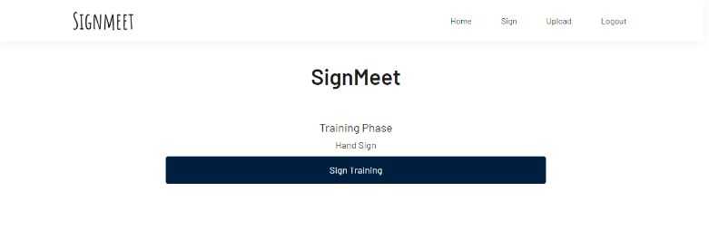

Slide 24
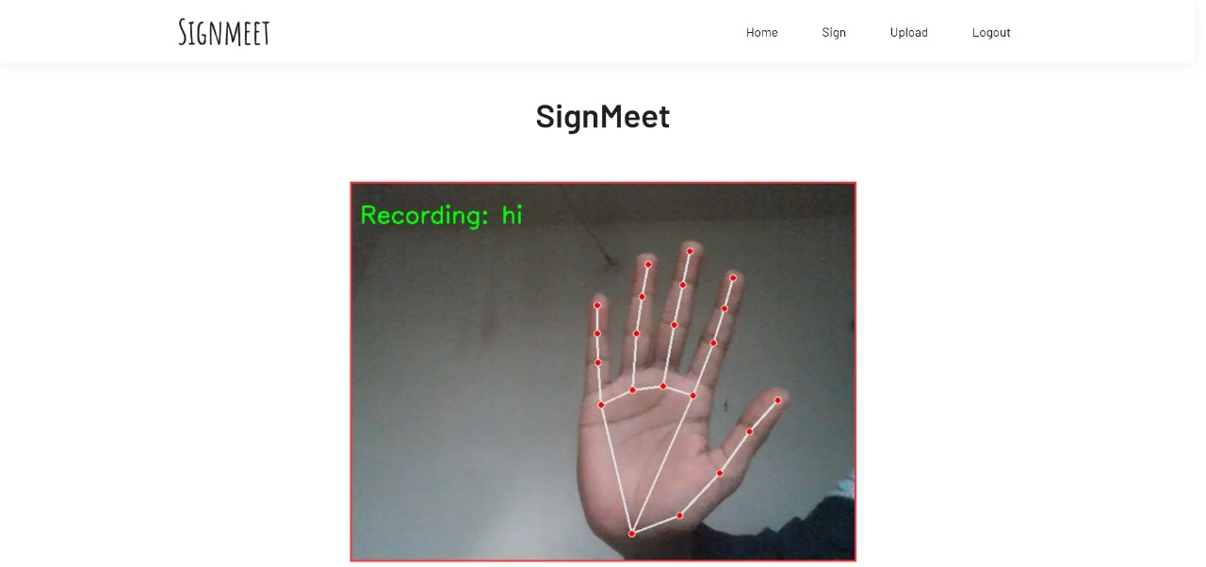

Slide 25


Slide 26
3. SignNet Model: Build and Train
In the process of building and training the SignNet Model for the Deaf Companion System, several essential steps are followed to ensure accuracy and effectiveness.
3.1. Import Dataset
In this initial phase, a diverse dataset is gathered and imported to serve as the foundational training data for the SignNet Model. This dataset comprises high-quality images representing various sign language gestures.
3.2. Preprocessing
This step involves a series of preprocessing tasks to enhance the dataset quality. It includes standardizing image dimensions, converting images to grayscale for simplicity, applying a Gabor Filter for noise reduction, and binarizing images to facilitate effective feature extraction.
3.3. Segmentation
Employing a Region Proposal Network (RPN), this step focuses on identifying and isolating distinct regions within the images. Segmentation is crucial for improving the model's ability to accurately recognize and interpret individual sign language gestures.

Slide 27
3.4. Feature Extraction
Implementing a Fully Connected Layer, this phase captures key features and nuances of the sign gestures.
3.5. Classification
Utilizing a Pooling Layer, this step categorizes the extracted features, aiding in the identification of specific sign language gestures based on the captured features.
3.6. Build and Train
This phase involves the development and training of the SignNet Model using Convolutional Neural Network (CNN) architecture. The model is trained on the preprocessed and segmented dataset, with parameters adjusted for optimal performance.
3.7. Deploy Model
The final step is the integration of the trained SignNet Model into the Deaf Companion System Web App. This integration allows for real-time sign language recognition, contributing to a seamless and inclusive communication experience for individuals with hearing and mute disabilities.

Slide 28
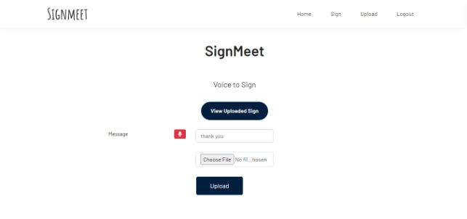

Slide 29
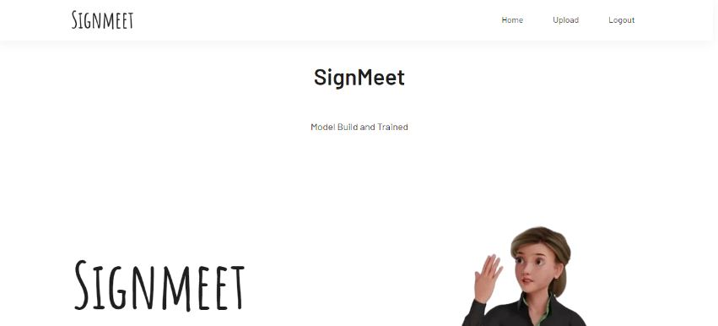

Slide 30
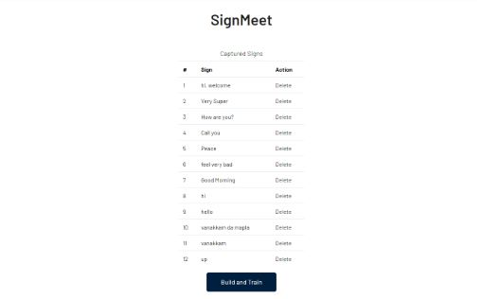

Slide 31
4. Sign Language Recognition
4.1. Live Video Call with Sign
This feature facilitates real-time communication for deaf users who can express sign language gestures through their webcams. The live video feed captures the dynamic nature of sign language, allowing users to convey messages seamlessly.
4.2. Recognize Sign
Employing Temporal Convolutional Networks (TCN) integrated with the SignNet Model, this step focuses on the recognition and interpretation of live sign language gestures. The TCN enhances temporal modeling, ensuring the model captures the dynamic nature of signs over time for accurate interpretation.
4.3. Multilanguage Interpretation
The Multilanguage Interpretation feature broadens the system's accessibility by allowing interpretation of sign language gestures in multiple languages. This ensures inclusivity and accommodates users with diverse linguistic preferences, making the system adaptable to a global audience.

Slide 32
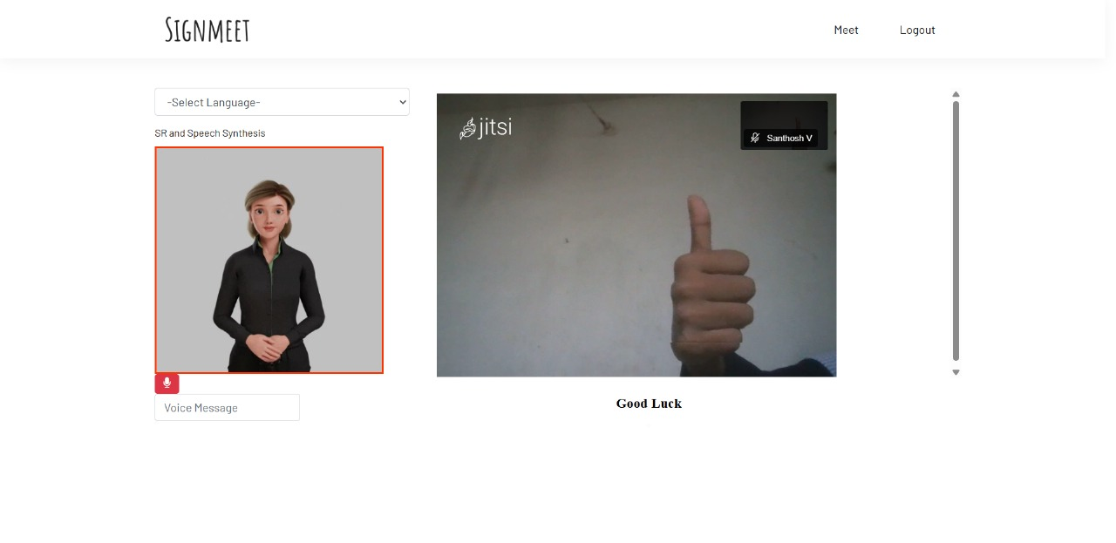

Slide 33
5. Speech Recognition and Synthesis
5.1. Speech Recognition
The Speech Recognition Module is designed to convert non-deaf speech into text, facilitating seamless communication with deaf individuals. Using Hidden Markov Models (HMM), the module captures the nuances of spoken language, translating them into textual representations.
5.2. Speech Synthesis
The Speech Synthesis Module generates spoken language output based on the recognized text, enhancing communication for non-deaf individuals. Leveraging text-to-speech (TTS) synthesis techniques, the module creates natural-sounding spoken output. The synthesized voice is then synchronized with predicted sign language gestures, providing a comprehensive and engaging communication experience for users.

Slide 34
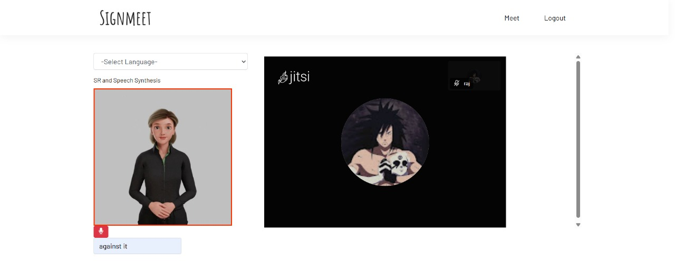

Slide 35
6. Visual Communication
The Avatar Generation module within the Deaf Companion System, designed to elevate the experience of visual communication. Dynamic Avatar Generation is to transform the text from a normal individual into sign language, which is then executed through an Avatar.
Dynamic Avatar Generation
Utilizes the recognized speech to dynamically generate visual representations of sign language avatars. The avatars are crafted in real-time, ensuring synchronization with the flow and nuances of the communicated message.
Synchronization
Intricately synchronizes with the rhythm and content of non-deaf speech, creating a seamless and harmonious connection between spoken words and visual representation.

Slide 36
CONCLUSION
It is an AI-powered virtual meeting accessibility solution that enhances communication for hearing-impaired users by integrating real-time sign language recognition and avatar-based translation.
The system enables seamless interaction in Virtual platforms, ensuring inclusivity in professional and educational settings.
By leveraging deep learning models for sign recognition, It provides a cost-effective and scalable solution for improving accessibility in virtual communication.

Slide 37
FUTURE SCOPE
This project can be further improved with advanced features and optimizations to enhance accessibility, accuracy, and user experience. Some key future enhancements include:
• Expanded Language Support: Incorporating additional sign languages, including regional and country-specific variations, to support a wider audience.
• Integration with More Virtual Platforms: Extending compatibility beyond Jitsi to platforms like Zoom, Microsoft Teams, and Google Meet, allowing broader adoption.
• Enhanced Avatar Customization: Improving the Avatar Module with realistic 3D animations, facial expressions, and lip-syncing for better sign language representation.
• Mobile App Development: Creating a mobile version of the project to allow accessibility on smartphones and tablets for on-the-go communication.
• Automated Meeting Transcription and Summarization: Implementing AI-based summarization tools to provide meeting notes and transcripts for improved accessibility and documentation.

Slide 38
REFERENCES
[1]. G. S. Özcan and Y. C. Bilge, “Hand and Pose-Based Feature Selection for Zero-Shot Sign Language Recognition,” IEEE Conference on Computer Vision and Pattern Recognition, pp. 1–10, 2024.
[2]. D. R. Kothadiya and C. M. Bhatt, “Hybrid InceptionNet Based Enhanced Architecture for Isolated Sign Language Recognition,” International Conference on Intelligent Computing and Signal Processing, pp. 112–118, 2024.
[3]. M. Zhang and S. Yang, “Deep Learning-Based Standard Sign Language Discrimination,” IEEE Transactions on Learning Technologies, Vol. 16, no. 1, pp. 45–57, 2023.
[4]. F. Morillas-Espejo, “Sign4all: A Low-Cost Application for Deaf People Communication,” Journal of Accessibility and Design for All, Vol. 13, no. 2, pp. 201–215, 2023.
[5]. H. Luqman, “An Efficient Two-Stream Network for Isolated Sign Language Recognition Using Accumulative Video Motion,” Multimedia Tools and Applications, Vol. 82, pp. 15093–15110, 2022.
[6]. J. DelPreto and J. Hughes, “A Wearable Smart Glove and Its Application of Pose and Gesture Detection to Sign Language Classification,” IEEE Sensors Journal, Vol. 22, no. 4, pp. 2958–2967, 2022.

Slide 39
Thank you

